Slide 1
Rocky Mountain Power Net Metering Public Workshop June 16, 2020 Participate by Calling: (801) 220-5252 or toll free (855) 499-5252 Enter conference ID: 4275950
Notes:
Choose from three different title slide designs by selecting “New Slide.” These slides are suitable for business and community presentations.

Slide 2
Public Input Process
Rocky Mountain Power is hosting this workshop to provide customers an opportunity to comment on its application and provide input on what should be considered in the study design phase.
The Idaho Public Utilities Commission staff will host another workshop on June 18th from 6-9 pm to allow staff to discuss its views on the Company’s application. Customers can participate by calling l-404-418-9388 and entering access code 126 921 8458.
A telephonic public customer hearing will be held on Monday, June 22nd, at 3:00 p.m. (MDT). Those wishing to offer verbal comments or listen can dial 1-800-920-7487, and enter passcode 6674832#.
Those interested in submitting written comments on the study design or grandfathering have until July 16, 2020, to do so. Comments must contain the case number (PAC-E-19-08). Those wishing to submit comments electronically may do so by visiting the Commission's home page at www.puc.idaho.gov. Click on the "Case Comment Form" under "Consumers" and complete the form using the case number, PAC-E-19-08.
Based on the customer input the parties have until July 2nd to submit revised comments, then the Commission will determine what items should be considered when determining the value of the Export Credit.

Slide 3
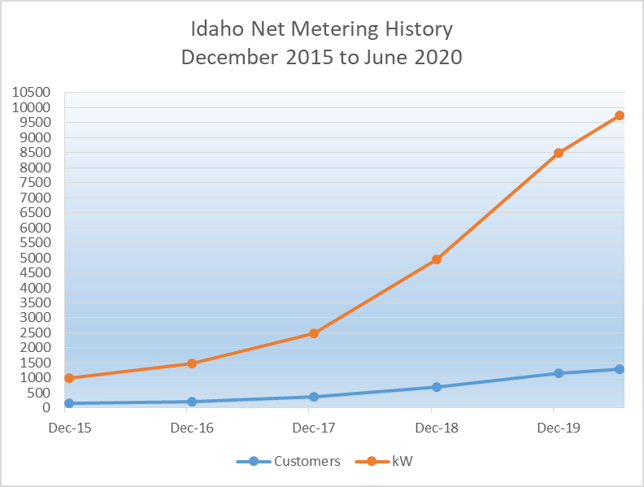
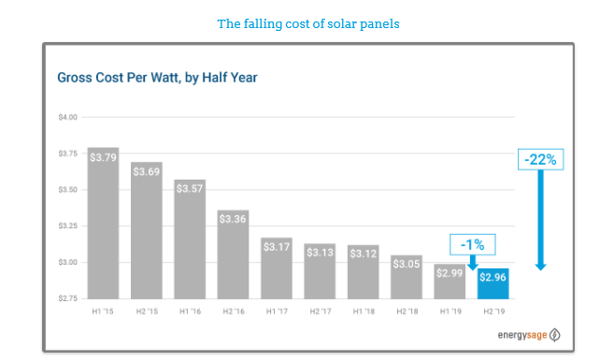
Idaho Net Metering Customers
Rocky Mountain Power has
experienced significant growth in
its Net Metering Program. As of
June 10 2020, RMP has 1,301
Net Metering customers with
approximately 9.7 MW of on-site
generation. Solar represents 97%
of the connected generation.
Notes:
Choose from three different title slide designs by selecting “New Slide.” These slides are suitable for business and community presentations.

Slide 4
Net Metering / Net Billing Process
Rocky Mountain Power began offering a net metering program in June 2003, the order approving the program stated: “The Commission recognizes that the full cost of the program we approve today may not be borne only by participants… As part of its report to the Commission, the Company should provide the differential between the net metering purchase price it pays at retail sales rates and the wholesale cost of alternative power supplies. We also expect further information from the Company regarding cost shifting and the Company’s ability to recover customer costs from program participants.” (Order No. 29260)
On June 14, 2019, Rocky Mountain Power filed with the Commission to close its Net Metering program to new customer participation and implement a new Net Billing program, with the main difference being the net metering purchase price the Company pays for exported energy, or the “Export Credit”.
On April 23, 2020, the Company supplemented its original application to update the Export Credit and implement a two-phase approach. Phase I to determine the study design, Phase II to calculate the Export Credit utilizing the study design approved in Phase I.

Slide 5
Schedule 135 – Net Metering Program
RMP’s Current Net Metering Program:
Eligible Generating Plant - A facility that uses energy derived from the sun, wind, water, biomass or fuel cell technology to generate electricity. An eligible generating plant may not have a generating capacity of more than twenty-five (25) kilowatts for customers taking service on Schedules 1, 36, 23 or 23A or one hundred (100) kilowatts for all other customers. To qualify, a customer must maintain its retail electric service account for the load served at the point of delivery adjacent to the generation interconnection point as active and in good standing.
Export Energy - If the energy generated by the customer and delivered to the Company exceeds the energy supplied by the Company, the exported energy is financially credited at the customer’s full retail rate for customers taking retail service under Schedules 1, 36, 23 or 23A. For all other customers the Export Energy credit equals 85 percent of the monthly weighted average of the daily on-peak and off-peak Mid-Columbia Intercontinental Exchange Electricity Price Index (Mid-C ICE Index) prices for non-firm energy. Credits shall remain on the account, and may only be used to offset the Customer’s energy charges at the meter originating the credit or other eligible meters (as outlined under Special Condition No. 12).
Excess Net Financial Credits - At the end of the customer’s February billing period the customer may request to transfer the unused financial credits to offset energy charges at the customer’s other eligible meters. Credits may be transferred to a meter or meters that meet the following criteria:
The meter is located on, or contiguous to, the premises on which the meter with excess financial credit is located;
The meter is served by the same primary feeder as the meter with the excess financial credits; and
The electricity recorded by the meter is on the same rate schedule as the meter with the excess financial credits.
Company proposal – Grandfather existing Net Metering customers on Schedule 135 for ten years.

Slide 6
Schedule 135 – Net Metering Program
Why is Rocky Mountain Power proposing changes to the net metering program?
The Company supports customers’ desire to install on-site generation and wants to ensure that other customers are not adversely impacted through higher rates because of that decision.
That’s why the Company recommended replacing the Net Metering program (Schedule 135) with a new Net Billing program (Schedule 136) to minimize cost shifting and send the appropriate price signals to customers interested in installing on-site generation.
Under Schedule 135, non-net metering customers are paying Net Metering customers the full retail rate for excess energy exported to the grid when that energy is available at much lower wholesale prices (market prices).
To mitigate this cost shift, the Company proposes to compensate customers for energy exported to the grid from their customer generation system at a price that fairly reflects that energy’s value (Export Credit) to the system and holds other customers economically indifferent.
For residential customers, most of the fixed costs to pay for and maintain the Company’s system are recovered through volumetric energy charges. Approximately 74 percent of the cost to serve residential customers are fixed, while only 7.8 percent of those costs are recovered through fixed charges.

Slide 7
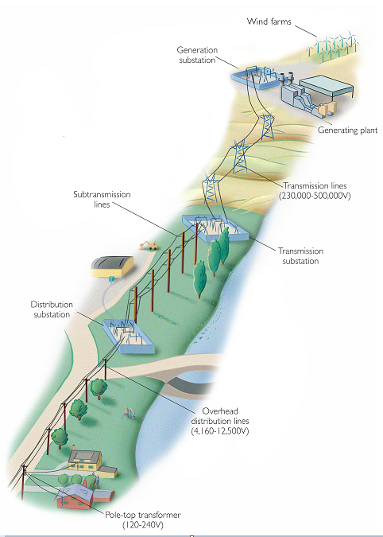
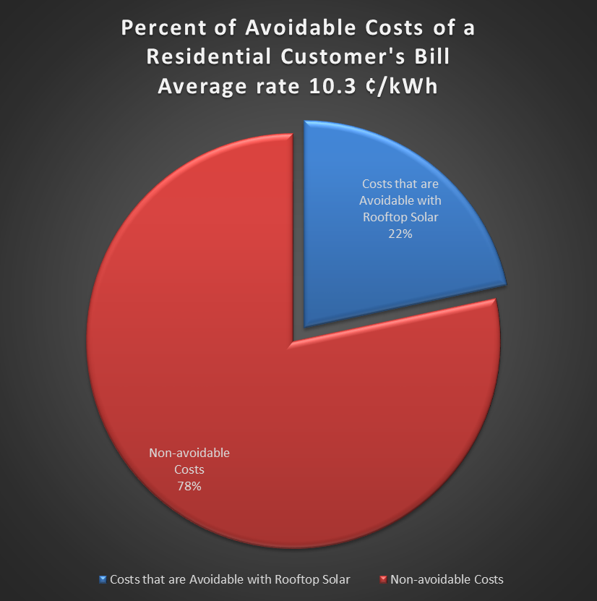
Components of Retail Rates
Total Average Residential Cost of Service: 10.3¢ per kWh
Generation (Non-avoidable cost): 3.8¢ per kWh
Generation (Avoidable costs): 2.2¢ per kWh
Transmission: 1.5¢ per kWh
Substation: 0.1¢ per kWh
Distribution Lines: 1.0¢
per kWh
Transformer, Service drop, Meter, and Customer Service: 1.7¢ per kWh
Notes:
Choose from three different title slide designs by selecting “New Slide.” These slides are suitable for business and community presentations.

Slide 8
Customers’ Demand vs Solar Exports
Notes:
Choose from three different title slide designs by selecting “New Slide.” These slides are suitable for business and community presentations.

Slide 9
Proposed Schedule 136 - Net Billing Program
Customers with owned generation resources who apply to connect their generation resource to the Company’s electrical system after July 30, 2020 would participate under Schedule 136 – Net Billing Program.
Schedule 136 allows customers to offset some or all of their own energy consumption to avoid the Company’s retail rate the same as Schedule 135.
How Schedule 136 differs from Schedule 135:
Implementation of a $85 application fee;
Export Credit of 2.2 cents per kWh rather than full retail rate. The Export Credit will be determined based on input from customers, interveners and the Company with the Commission making the final decision.
The Export Credit would be updated annually on June 1st.
How does the average residential customer’s payback period compare under the two programs:
Under Schedule 135 the average customer payback is estimated to be 9.0 years;
Under Schedule 136 the average customer payback is estimated to be 13.6 years.

Slide 10
Proposed Components of Export Credit
The Company proposes the following components are appropriately included in the Export Credit:
Avoided Energy Costs: include on-peak and off-peak pricing based on Energy Imbalance Market (“EIM”) prices multiplied by 85 percent for non-firm energy similar to all other customers (excluding nonresidential and small commercial) under Schedule 135. The updated prices from calendar year 2019 support an average annual export credit of 1.923 cents per kWh.
Avoided Line Losses: residential generation exports travel across the distribution network, avoided line losses on the transmission network. The average value of avoided line losses during the twelve months ending May 31, 2021 is 0.336 cents per kWh.
Integration Costs: represent the cost of holding reserves with flexible resources to reliably maintain the load and resource balance, the 2019 IRP integration costs of 0.025 cents per kWh.
Other Items considered but not included as quantifiable or applicable costs and benefits: capacity costs, distribution costs, environmental benefits, impact on local economy and taxes, cap on the size of systems.

Slide 11
Calculation of the Export Credit

Slide 12
Renewable Resource Options
Low-cost utility-scale renewable resources are a major part of PacifiCorp’s resource planning.
PacifiCorp’s 2019 Integrated Resource Plan (IRP) identified over 6,400 megawatts (MW) of new renewable resources by the end of 2023, with nearly 11,000 MW of new renewable resources over the 20-year planning period through 2038.
Wind and solar generation is projected to be roughly half of PacifiCorp’s resource mix by 2030.
Selected resource cost estimates from the 2019 IRP, for resources online by 12/31/2023
Resource Capacity Factor 20-year Levelized Price
Wind (Medicine Bow, WY) 43.6% $25.35
Solar (Milford, UT) 32.5% $30.98
Wind (Pocatello, ID) 37.1% $32.42
Solar (Idaho Falls, ID) 28.1% $35.54

Slide 13
Any Questions or Comments

